Slide 1
Machine Learning
Saravana

Slide 2
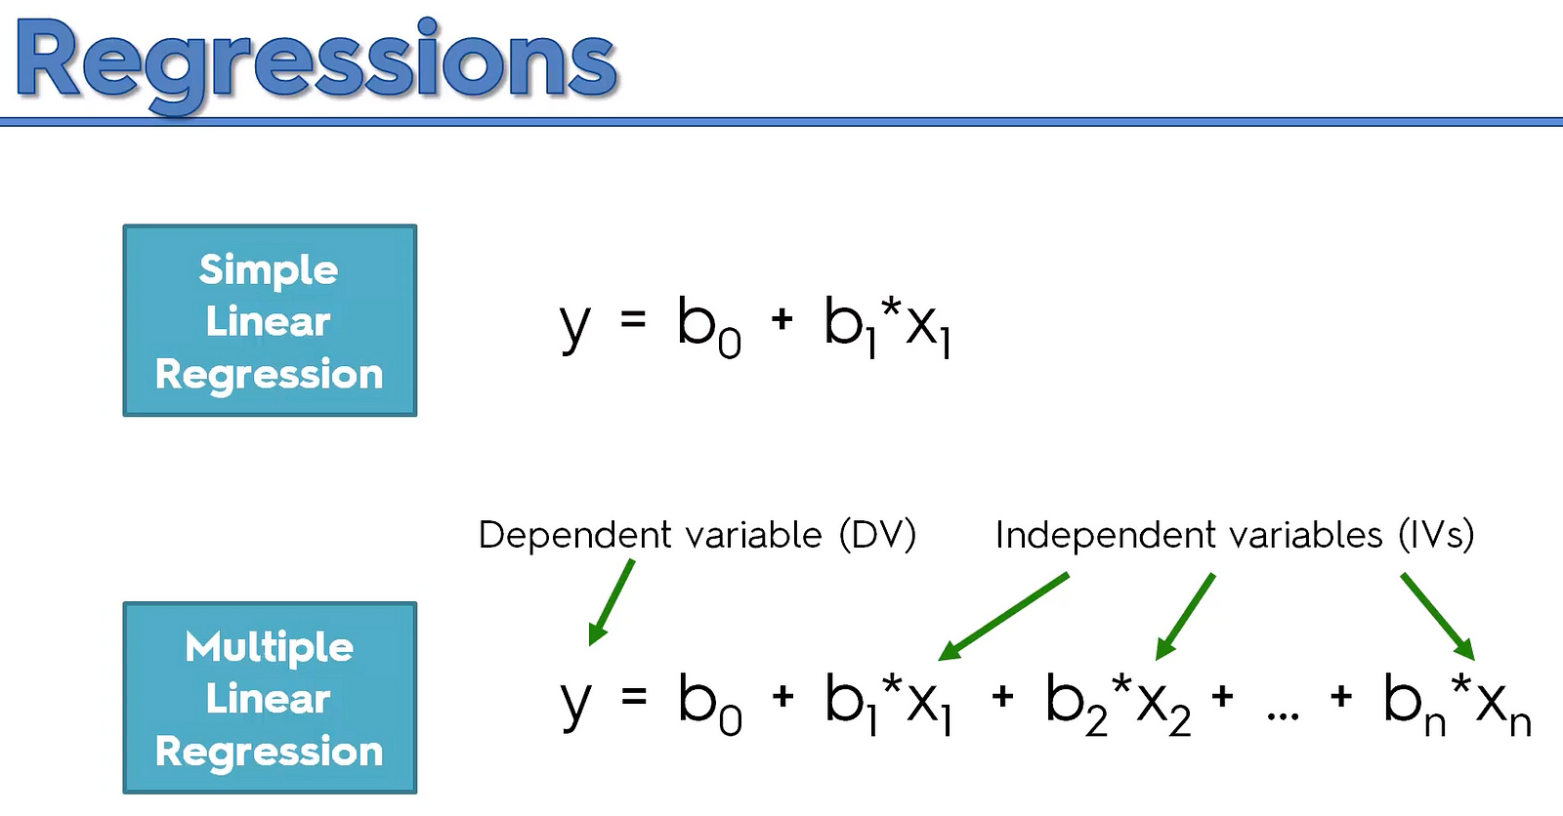
Linear Regression

Slide 3
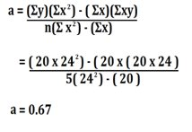
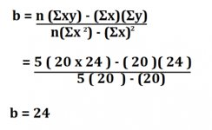
Linear Regression

Slide 4
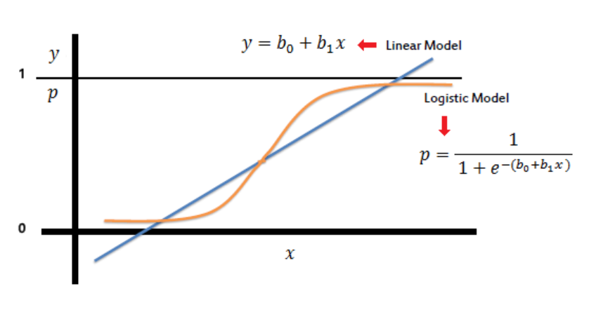
Logistic Regression

Slide 5
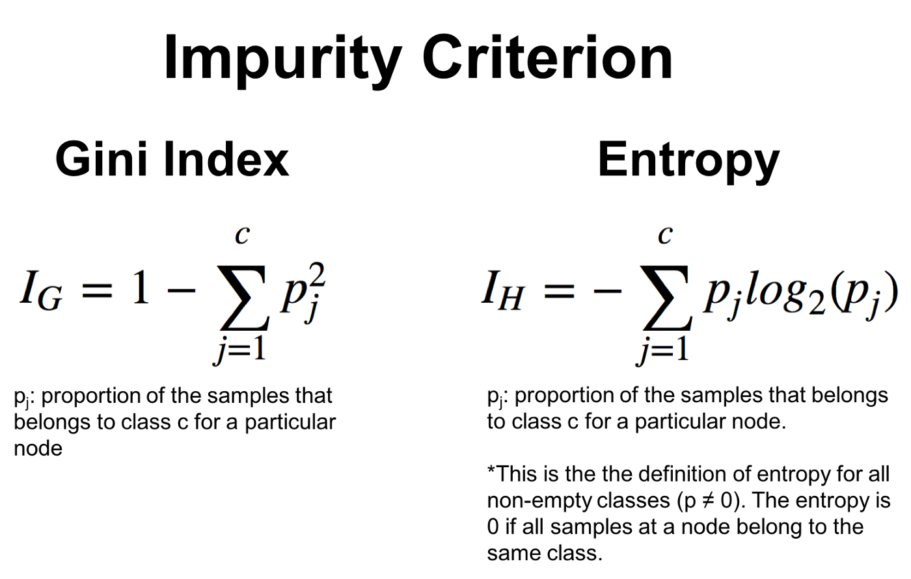
Decision Tree

Slide 6
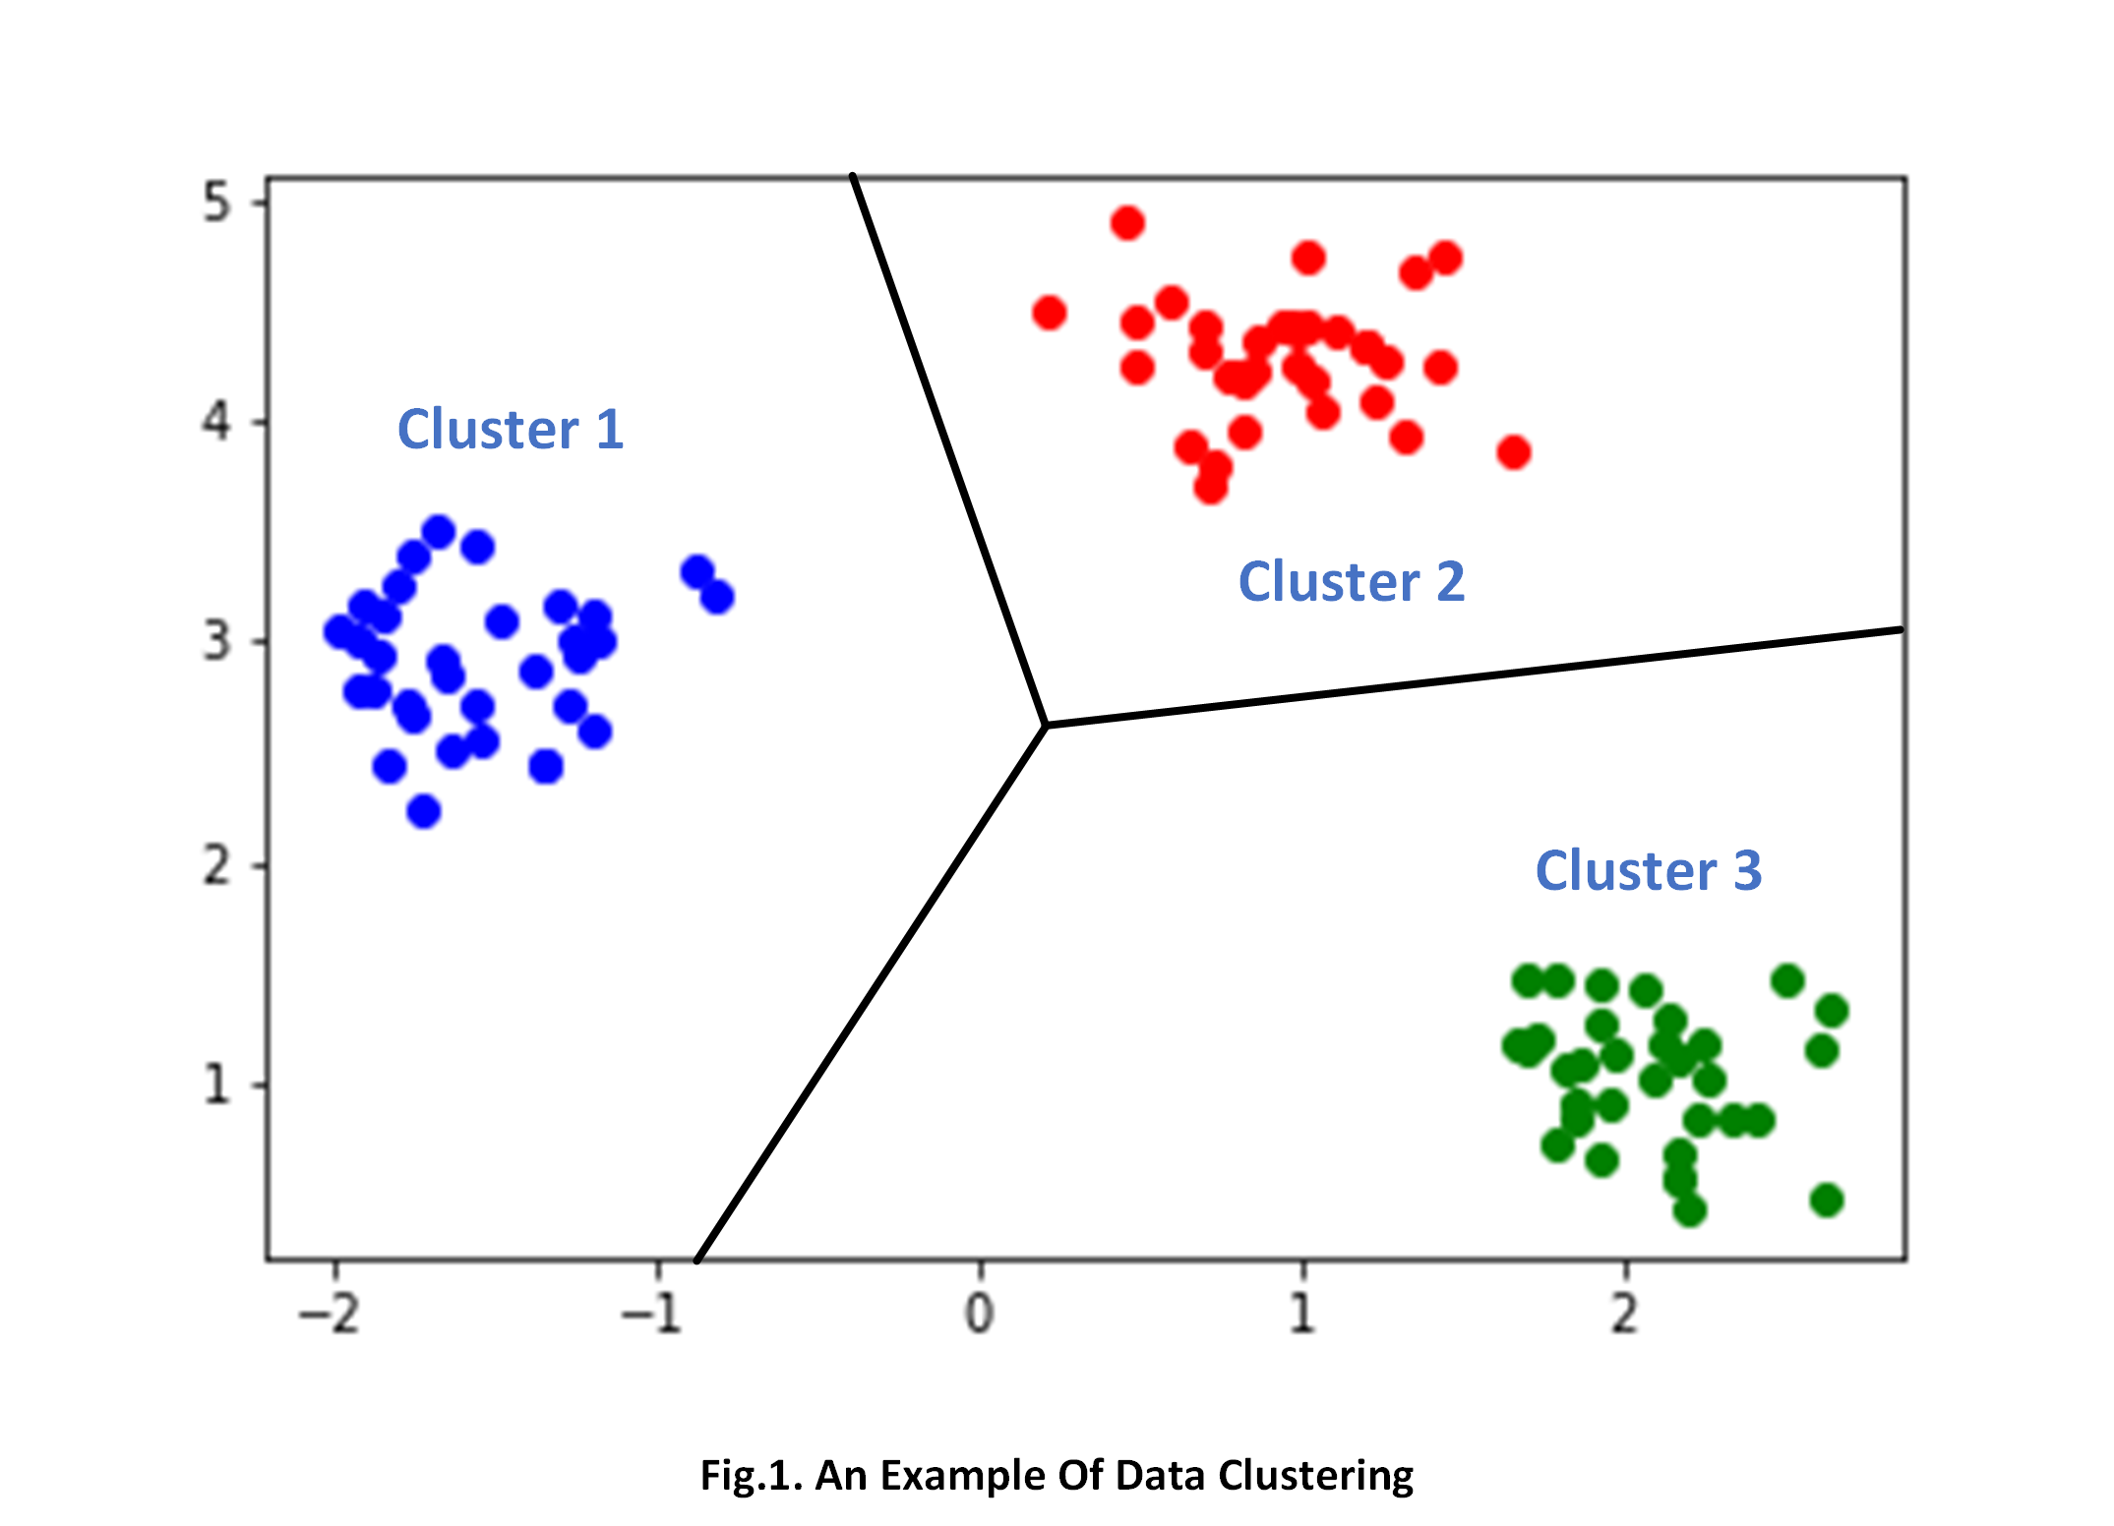
K Means & KNN
KMeans Clustering

Slide 7
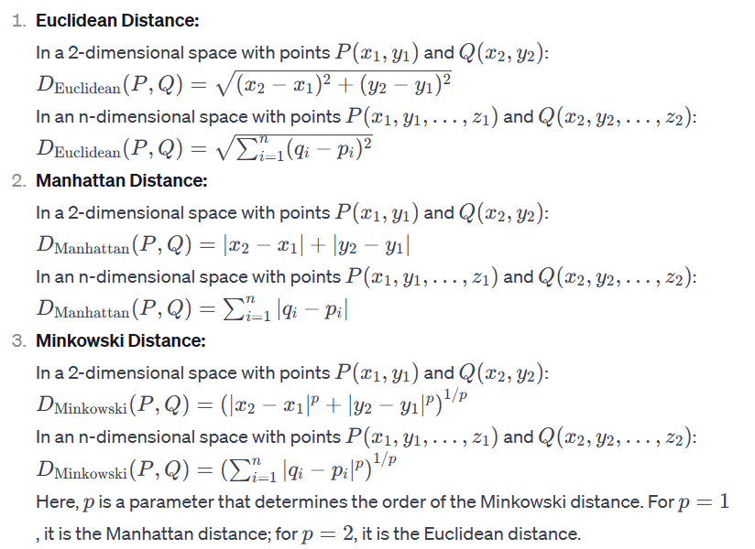
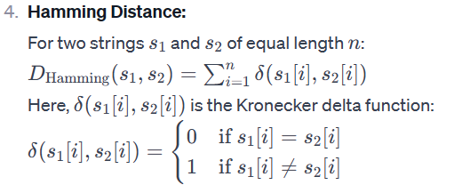
Distance Metrics in ML
Euclidean Distance
Manhattan Distance
Minkowski Distance
Hamming Distance

Slide 8

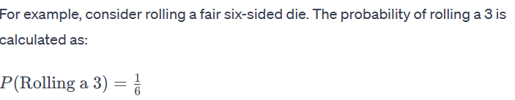
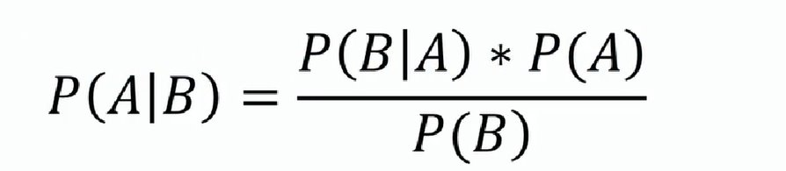
Naïve Bayes
Probability is typically represented as a number between 0 and 1, where 0 indicates an impossible event, 1 indicates a certain event, and values between 0 and 1 represent the likelihood of an event occurring.

Slide 9
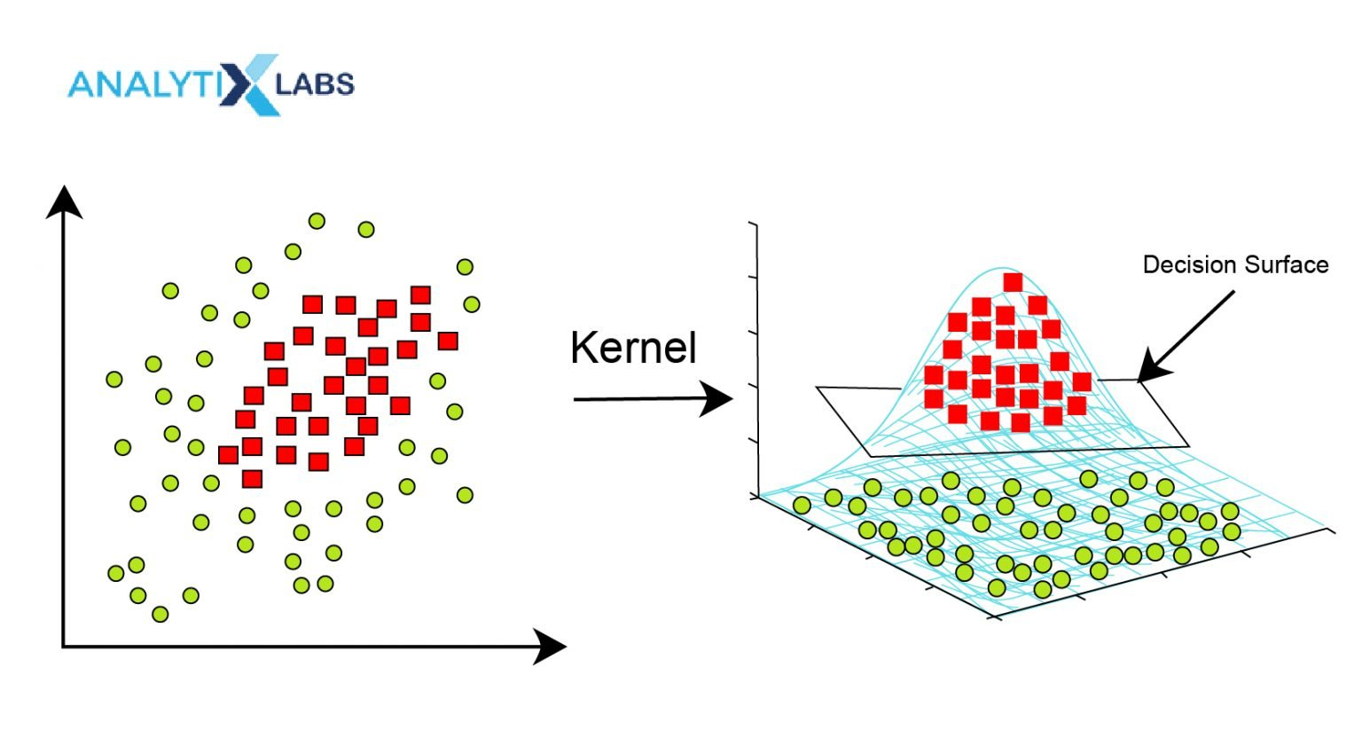
Support Vector Machine
Objective: SVM aims to find a hyperplane that best separates the data into different classes.
Hyperplane: In a two-dimensional space, a hyperplane is a simple line, and in higher dimensions, it becomes a plane or a hyperplane.
Margin: The hyperplane is chosen to maximize the margin, which is the distance between the hyperplane and the nearest data point from either class. This ensures a robust separation.

Slide 10
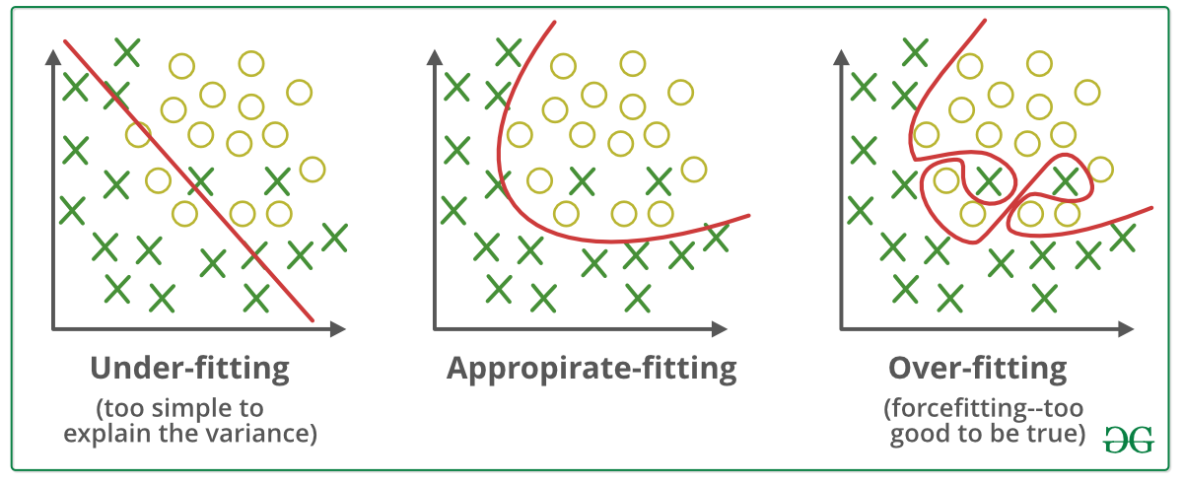
Regularization
Overfitting is a phenomenon that occurs when a Machine Learning model is constrained to the training set and not able to perform well on unseen data. That is when our model learns the noise in the training data as well. This is the case when our model memorizes the training data instead of learning the patterns in it.
Underfitting on the other hand is the case when our model is not able to learn even the basic patterns available in the dataset. In the case of the underfitting model is unable to perform well even on the training data hence we cannot expect it to perform well on the validation data. This is the case when we are supposed to increase the complexity of the model or add more features to the feature set.

Slide 11
Gradient Boosting
Cost Function:
In machine learning, a cost function (or loss function) measures how well the model's predictions match the actual outcomes. The goal is to minimize this cost function.
Model Parameters:
The machine learning model has parameters (weights and biases) that determine its behavior. The cost function depends on these parameters.
Gradient Calculation:
The gradient of the cost function with respect to the model parameters is calculated. The gradient is a vector that points in the direction of the steepest increase of the cost function.
Parameter Update:
The model parameters are updated in the opposite direction of the gradient to decrease the cost. The size of the update is controlled by a learning rate.
Iterative Process:
Steps 3 and 4 are repeated iteratively until the cost function converges to a minimum or a predefined number of iterations is reached.

Slide 12
Types of Gradient Descent
Batch Gradient Descent:
The entire training dataset is used to compute the gradient of the cost function in each iteration.
Stochastic Gradient Descent (SGD):
Only one randomly selected training example is used in each iteration to compute the gradient. This is computationally less expensive but may result in more erratic updates.
Mini-Batch Gradient Descent:
A small random subset of the training data (a mini-batch) is used in each iteration. This combines some advantages of both batch and stochastic gradient descent.

Slide 13
Thanks

